Slide 1
XML Design
(A Gentle Transition from XML to RDF)

Slide 2
What is the Purpose of RDF?
The purpose of RDF (Resource Description Framework) is to give a standard way of specifying data "about" something.
Here's an example of an XML document that specifies data about China's Yangtze river:
<?xml version="1.0"?>
<River id="Yangtze"
xmlns="http://www.geodesy.org/river">
<length>6300 kilometers</length>
<startingLocation>western China's Qinghai-Tibet Plateau</startingLocation>
<endingLocation>East China Sea</endingLocation>
</River>
"Here is data about the Yangtze River. It has a length of 6300 kilometers.
Its startingLocation is western China's Qinghai-Tibet Plateau. Its endingLocation
is the East China Sea."

Slide 3
XML --> RDF
Modify the following XML document so that it is also a valid RDF document:
<?xml version="1.0"?>
<River id="Yangtze"
xmlns="http://www.geodesy.org/river">
<length>6300 kilometers</length>
<startingLocation>western China's Qinghai-Tibet Plateau</startingLocation>
<endingLocation>East China Sea</endingLocation>
</River>
XML
Yangtze.xml
"convert to"
<?xml version="1.0"?>
<River rdf:ID="Yangtze"
xmlns:rdf="http://www.w3.org/1999/02/22-rdf-syntax-ns#"
xmlns="http://www.geodesy.org/river#">
<length>6300 kilometers</length>
<startingLocation>western China's Qinghai-Tibet Plateau</startingLocation>
<endingLocation>East China Sea</endingLocation>
</River>
RDF
Yangtze.rdf

Slide 4
The RDF Format
1
RDF provides an ID attribute for identifying the resource being described.
2
The ID attribute is in the RDF namespace.
<?xml version="1.0"?>
<River rdf:ID="Yangtze"
xmlns:rdf="http://www.w3.org/1999/02/22-rdf-syntax-ns#"
xmlns="http://www.geodesy.org/river#">
<length>6300 kilometers</length>
<startingLocation>western China's Qinghai-Tibet Plateau</startingLocation>
<endingLocation>East China Sea</endingLocation>
</River>
3
Add the "fragment identifier symbol" to
the namespace.

Slide 5
The RDF Format (cont.)
2
Identifies the resource being described. This
resource is an instance of River.
1
Identifies the type
(class) of the
resource being
described.
<?xml version="1.0"?>
<River rdf:ID="Yangtze"
xmlns:rdf="http://www.w3.org/1999/02/22-rdf-syntax-ns#"
xmlns="http://www.geodesy.org/river#">
<length>6300 kilometers</length>
<startingLocation>western China's Qinghai-Tibet Plateau</startingLocation>
<endingLocation>East China Sea</endingLocation>
</River>
3
These are properties,
or attributes, of the
type (class).
4
Values of the properties

Slide 6
The RDF Format
<?xml version="1.0"?>
<Class rdf:ID="Resource"
xmlns:rdf="http://www.w3.org/1999/02/22-rdf-syntax-ns#"
xmlns="uri">
<property>value</property>
<property>value</property>
...
</Class>

Slide 7
Advantage of using the RDF Format
You may ask: "Why should I bother designing my XML to be in the RDF format?"
Answer: there are numerous benefits:
  The RDF format, if widely used, will help to make XML more interoperable:
    Tools can instantly characterize the structure, "this element is a type (class), and here are its properties”.
    RDF promotes the use of standardized vocabularies ... standardized types (classes) and standardized properties.
  The RDF format gives you a structured approach to designing your XML documents. The RDF format is a regular, recurring pattern.
  It enables you to quickly identify weaknesses and inconsistencies of non-RDF-compliant XML designs. It helps you to better understand your data!
  You reap the benefits of both worlds:
    You can use standard XML editors and validators to create, edit, and validate your XML.
    You can use the RDF tools to apply inferencing to the data.
  It positions your data for the Semantic Web!
Interoperability
Network effect

Slide 8
Uniquely Identify the Resource
Earlier we said that RDF is very concerned about uniquely identifying the type (class) and the properties. RDF is also very concerned about uniquely identifying the resource, e.g.,
This is the resource being described. We want to uniquely
identify this resource.
<?xml version="1.0"?>
<River rdf:ID="Yangtze"
xmlns:rdf="http://www.w3.org/1999/02/22-rdf-syntax-ns#"
xmlns="http://www.geodesy.org/river#">
<length>6300 kilometers</length>
<startingLocation>western China's Qinghai-Tibet Plateau</startingLocation>
<endingLocation>East China Sea</endingLocation>
</River>

Slide 9
rdf:ID
The value of rdf:ID is a "relative URI".
The "complete URI" is obtained by concatenating the URL of the XML document with "#" and then the value of rdf:ID, e.g.,
<?xml version="1.0"?>
<River rdf:ID="Yangtze"
xmlns:rdf="http://www.w3.org/1999/02/22-rdf-syntax-ns#"
xmlns="http://www.geodesy.org/river#">
<length>6300 kilometers</length>
<startingLocation>western China's Qinghai-Tibet Plateau</startingLocation>
<endingLocation>East China Sea</endingLocation>
</River>
Yangtze.rdf
Suppose that this RDF/XML document is located at this URL: http://www.china.org/geography/rivers.
Thus, the complete URI for this resource is:
http://www.china.org/geography/rivers#Yangtze

Slide 10
xml:base
On the previous slide we showed how the URL of the document provided the base URI.
Depending on the location of the document is brittle: it will break if the document is moved, or is copied to another location.
A more robust solution is to specify the base URI in the document, e.g.,
<?xml version="1.0"?>
<River rdf:ID="Yangtze"
xmlns:rdf="http://www.w3.org/1999/02/22-rdf-syntax-ns#"
xmlns="http://www.geodesy.org/river#"
xml:base="http://www.china.org/geography/rivers">
<length>6300 kilometers</length>
<startingLocation>western China's Qinghai-Tibet Plateau</startingLocation>
<endingLocation>East China Sea</endingLocation>
</River>
Resource URI = concatenation(xml:base, '#', rdf:ID)
= concatenation(http://www.china.org/geography/rivers, '#', "Yangtze")
= http://www.china.org/geography/rivers#Yangtze

Slide 11
rdf:about
Instead of identifying a resource with a relative URI (which then requires a base URI to be prepended), we can give the complete identity of a resource. However, we use rdf:about, rather than rdf:ID, e.g.,
<?xml version="1.0"?>
<River rdf:about="http://www.china.org/geography/rivers#Yangtze"
xmlns:rdf="http://www.w3.org/1999/02/22-rdf-syntax-ns#"
xmlns="http://www.geodesy.org/river#">
<length>6300 kilometers</length>
<startingLocation>western China's Qinghai-Tibet Plateau</startingLocation>
<endingLocation>East China Sea</endingLocation>
</River>

Slide 12
Triple -> resource/property/value
http://www.china.org/geography/rivers#Yangtze has a http://www.geodesy.org/river#length of 6300 kilometers
resource
property
value
http://www.china.org/geography/rivers#Yangtze has a http://www.geodesy.org/river#startingLocation of western China's ...
resource
property
value
http://www.china.org/geography/rivers#Yangtze has a http://www.geodesy.org/river#endingLocation of East China Sea
resource
property
value

Slide 13
The RDF Format = triples!
The fundamental design pattern of RDF is to structure your XML data as resource/property/value triples!
<?xml version="1.0"?>
<Resource-A>
<property-A>
<Resource-B>
<property-B>
<Resource-C>
<property-C>
Value-C
</property-C>
</Resource-C>
</property-B>
</Resource-B>
</property-A>
</Resource-A>
Notice that the RDF design pattern is an
alternating sequence of resource-property.
This pattern is known as "striping".
value of
property-A
value of
property-B
The value of a property can be a literal (e.g., length has a value of 6300 kilometers).
Also, the value of a property can be a resource, as shown above (e.g., property-A
has a value of Resource-B, property-B has a value of Resource-C). We will see examples
of properties having a resource value in a little bit.

Slide 14
Naming Convention
The convention is to use a capital letter to start a type (class) name, and use a lowercase letter to start a property name.
  This helps the eye quickly discern the striping pattern.
<?xml version="1.0"?>
<River rdf:about="http://www.china.org/geography/rivers#Yangtze"
xmlns:rdf="http://www.w3.org/1999/02/22-rdf-syntax-ns#"
xmlns="http://www.geodesy.org/river#">
<length>6300 kilometers</length>
<startingLocation>western China's Qinghai-Tibet Plateau</startingLocation>
<endingLocation>East China Sea</endingLocation>
</River>
uppercase
lowercase

Slide 15
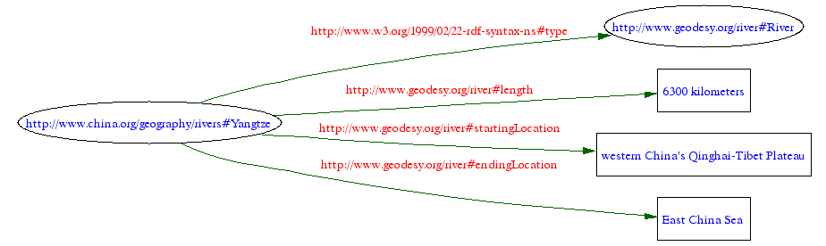
RDF Model (graph)
Legend:
Ellipse indicates "Resource"
Rectangle indicates "literal string value"

Slide 16
rdf:Description + rdf:type
There is still another way of representing the XML. This way makes it very clear that you are describing something, and it makes it very clear what the type (class) is of the thing you are describing:
<?xml version="1.0"?>
<rdf:Description rdf:about="http://www.china.org/geography/rivers#Yangtze"
xmlns:rdf="http://www.w3.org/1999/02/22-rdf-syntax-ns#"
xmlns="http://www.geodesy.org/river#">
<rdf:type rdf:resource="http://www.geodesy.org/river#River"/>
<length>6300 kilometers</length>
<startingLocation>western China's Qinghai-Tibet Plateau</startingLocation>
<endingLocation>East China Sea</endingLocation>
</rdf:Description>
This is read as: "This is a Description about the resource http://www.china.org/geography/rivers#Yangtze.
This resource is an instance of the River type (class). The http://www.china.org/geography/rivers#Yangtze
resource has a length of 6300 kilometers, a startingLocation of western China's Qinghai-Tibet Plateau,
and an endingLocation of the East China Sea."
Note: this form of describing a resource is called the "long form". The form we have seen previously is an
abbreviation of this long form. An RDF Parser interprets the abbreviated form as if it were this long form.

Slide 17
Alternative
Alternatively we can use rdf:ID rather than rdf:about, as shown here:
<?xml version="1.0"?>
<rdf:Description rdf:ID="Yangtze"
xmlns:rdf="http://www.w3.org/1999/02/22-rdf-syntax-ns#"
xmlns="http://www.geodesy.org/river#"
xml:base="http://www.china.org/geography/rivers">
<rdf:type rdf:resource="http://www.geodesy.org/river#River"/>
<length>6300 kilometers</length>
<startingLocation>western China's Qinghai-Tibet Plateau</startingLocation>
<endingLocation>East China Sea</endingLocation>
</rdf:Description>

Slide 18
Terminology
As you read the RDF literature you may see the following terminology:
  Subject: this term refers to the item that is playing the role of the resource.
  predicate: this term refers to the item that is playing the role of the property.
  Object: this term refers to the item that is playing the role of the value.
Subject
predicate
Object
Equivalent!
Resource
property
Value

Slide 19
RDF Parser
There is a nice RDF parser at the W3 Web site:
http://www.w3.org/RDF/Validator/
This RDF parser will tell you if your XML
is in the proper RDF format.

Slide 20
Example #2
Modify the following XML document so that it is RDF-compliant:
<?xml version="1.0"?>
<River id="Yangtze"
xmlns="http://www.geodesy.org/river">
<length>6300 kilometers</length>
<startingLocation>western China's Qinghai-Tibet Plateau</startingLocation>
<endingLocation>East China Sea</endingLocation>
<Dam id="ThreeGorges"
xmlns="http://www.geodesy.org/dam">
<name>The Three Gorges Dam</name>
<width>1.5 miles</width>
<height>610 feet</height>
<cost>$30 billion</cost>
</Dam>
</River>
Yangtze2.xml

Slide 21
Note the two types (classes)
River
Dam
Instance: Yangtze
Properties:
length
startingLocation
endingLocation
Instance: ThreeGorges
Properties:
name
width
height
cost

Slide 22
Dam - out of place
<?xml version="1.0"?>
<River id="Yangtze"
xmlns="http://www.geodesy.org/river">
<length>6300 kilometers</length>
<startingLocation>western China's Qinghai-Tibet Plateau</startingLocation>
<endingLocation>East China Sea</endingLocation>
<Dam id="ThreeGorges"
xmlns="http://www.geodesy.org/dam">
<name>The Three Gorges Dam</name>
<width>1.5 miles</width>
<height>610 feet</height>
<cost>$30 billion</cost>
</Dam>
</River>
Dam
Types (classes) contain properties . Here we see the River type containing the properties - length, startingLocation, and endingLocation. It also shows River containing a type - Dam. Thus, there is a Resource that contains another Resource. This is inconsistent with RDF design pattern. (We are seeing one of the benefits of using the RDF format - to identify inconsistencies in an XML design.)

Slide 23
Property value must be a
Literal or a Resource
<length>6300 kilometers</length>
property
Value is a Literal
property
<obstacle>
<Dam id="ThreeGorges"
xmlns="http://www.geodesy.org/dam">
<name>The Three Gorges Dam</name>
<width>1.5 miles</width>
<height>610 feet</height>
<cost>$30 billion</cost>
</Dam>
</obstacle>
Value is a Resource

Slide 24
Modified XML (to make it consistent)
<?xml version="1.0"?>
<River id="Yangtze"
xmlns="http://www.geodesy.org/river">
<length>6300 kilometers</length>
<startingLocation>western China's Qinghai-Tibet Plateau</startingLocation>
<endingLocation>East China Sea</endingLocation>
<obstacle>
<Dam id="ThreeGorges"
xmlns="http://www.geodesy.org/dam">
<name>The Three Gorges Dam</name>
<width>1.5 miles</width>
<height>610 feet</height>
<cost>$30 billion</cost>
</Dam>
</obstacle>
</River>
Yangtze2,v2.xml
"The Yangtze River has an obstacle that is the ThreeGorges Dam. The Dam
has a name - The Three Gorges Dam. It has a width of 1.5 miles, a height of 610 feet,
and a cost of $30 billion."

Slide 25
RDF Format
<?xml version="1.0"?>
<River rdf:ID="Yangtze"
xmlns:rdf="http://www.w3.org/1999/02/22-rdf-syntax-ns#"
xmlns="http://www.geodesy.org/river#"
xml:base="http://www.china.org/geography/rivers">
<length>6300 kilometers</length>
<startingLocation>western China's Qinghai-Tibet Plateau</startingLocation>
<endingLocation>East China Sea</endingLocation>
<obstacle>
<Dam rdf:ID="ThreeGorges"
xmlns="http://www.geodesy.org/dam#">
<name>The Three Gorges Dam</name>
<width>1.5 miles</width>
<height>610 feet</height>
<cost>$30 billion</cost>
</Dam>
</obstacle>
</River>
Changed id to rdf:ID
Added the '#' symbol
As always, the other representations using rdf:about and rdf:Description are available.

Slide 26
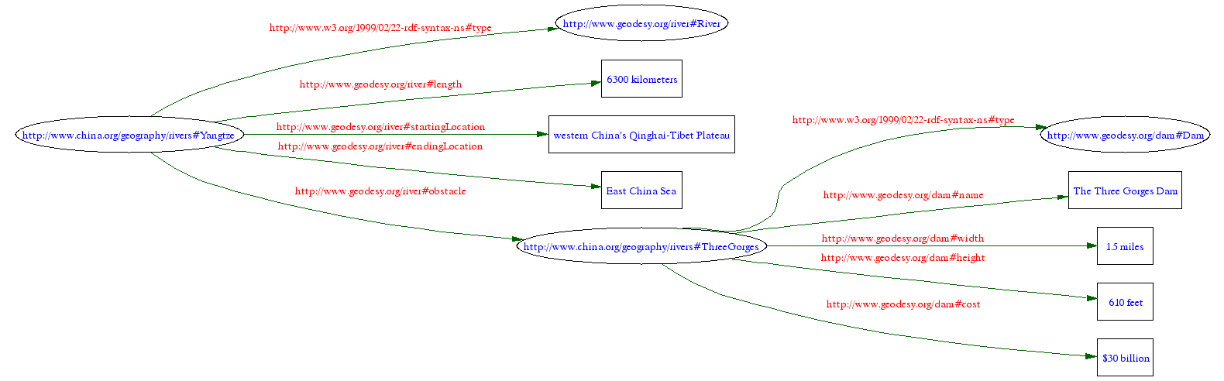
RDF Model (graph)

Slide 27
Alternatively, suppose that someone has already created a document containing
information about the Three Gorges Dam:
<?xml version="1.0"?>
<Dam rdf:ID="ThreeGorges"
xmlns:rdf="http://www.w3.org/1999/02/22-rdf-syntax-ns#"
xmlns="http://www.geodesy.org/dam#"
xml:base="http://www.china.org/geography/rivers">
<name>The Three Gorges Dam</name>
<width>1.5 miles</width>
<height>610 feet</height>
<cost>$30 billion</cost>
</Dam>
Three-Gorges-Dam.rdf
Then we can simply reference the Three Gorges Dam resource using rdf:resource,
as shown here:
<?xml version="1.0"?>
<River rdf:ID="Yangtze"
xmlns:rdf="http://www.w3.org/1999/02/22-rdf-syntax-ns#"
xmlns="http://www.geodesy.org/river#"
xml:base="http://www.china.org/geography/rivers">
<length>6300 kilometers</length>
<startingLocation>western China's Qinghai-Tibet Plateau</startingLocation>
<endingLocation>East China Sea</endingLocation>
<obstacle rdf:resource="http://www.china.org/geography/rivers#ThreeGorges"/>
</River>
Yangtze.rdf

Slide 28
Related Articles
"Make Your XML RDF-Friendly" by Bob DuCharme, John Cowan
http://www.xml.com/pub/a/2002/10/30/rdf-friendly.html

